Slide 1


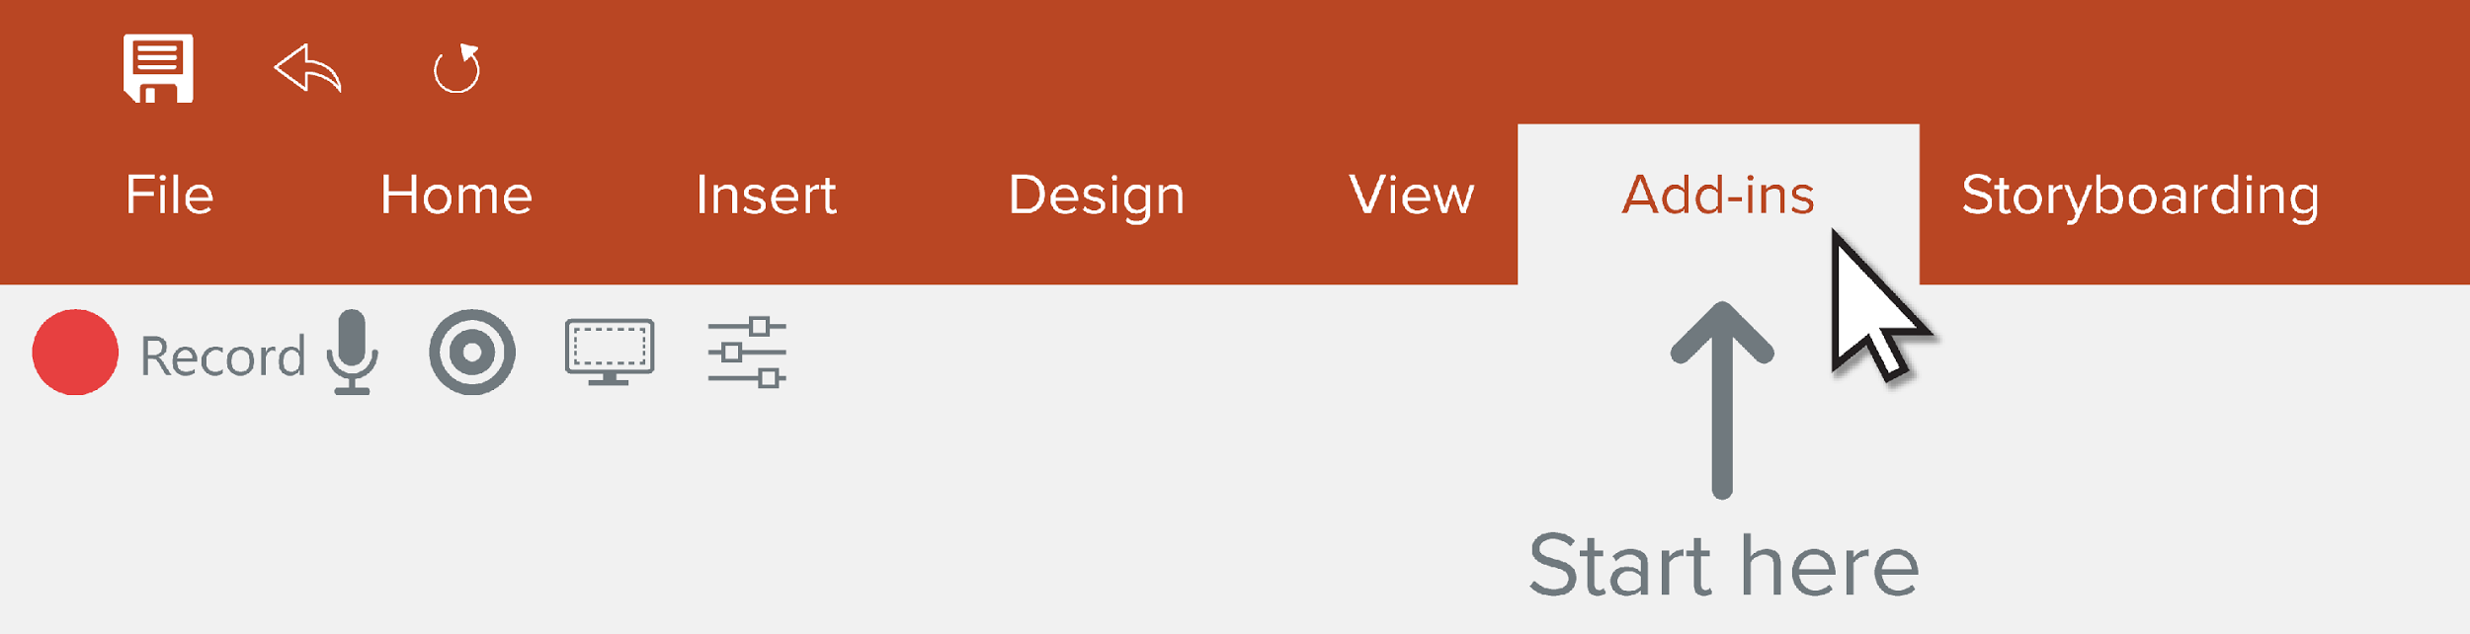
Record a Presentation
Use the Camtasia Add-in to record your presentations. Start by going to the Add-ins tab.
Mobile Addiction Analysis

Slide 2




Camtasia Recording Toolbar
About
This project analyzes mobile phone usage to understand addiction behavior.
It helps identify screen time, app usage, and addiction levels of users.
The dataset includes details like age, gender, screen time, and usage patterns.
The collected data is visualized using charts and KPIs in the dashboard.
This dashboard supports better awareness and healthy mobile usage habits.
Begin
recording
Toggle camera
recording
Adjust specific
recording options
Toggle microphone
recording
Display camera
preview

Slide 3
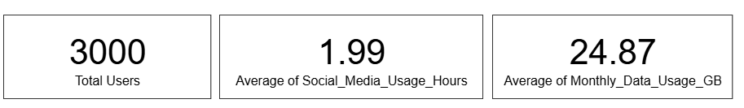
Camtasia Recording Toolbar
.
Cards – Overview of User Activity Metrics
Begin
recording
Toggle camera
recording
Adjust specific
recording options
These three cards display key summary metrics of the dataset in a simple and clear way.
The Total Users card shows that the dataset contains 3000 users.
The Average Social Media Usage card indicates users spend about 1.99 hours per day on social media.
The Average Monthly Data Usage card shows users consume around 24.87 GB per month.
Toggle microphone
recording
Display camera
preview

Slide 4
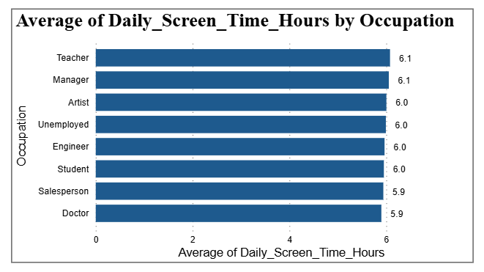
Camtasia Recording Toolbar
Bar Chart – Average Daily Screen Time by Occupation
Begin
recording
Toggle camera
recording
Adjust specific
recording options
This chart shows how many hours different professionals use mobile phones daily.
Teachers and Managers have the highest screen time, around 6 hours per day.
Most occupations show similar high mobile usage.
Toggle microphone
recording
Display camera
preview

Slide 5
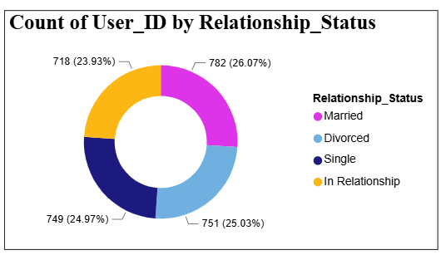
Camtasia Recording Toolbar
Donut Chart – Country and Self-Reported Addiction Level
Begin
recording
Toggle camera
recording
Adjust specific
recording options
This chart shows the number of users in each relationship category.
Married users have the highest count among all groups.
Single, Divorced, and In-Relationship users have similar numbers.
The data shows a balanced distribution of users.
Toggle microphone
recording
Display camera
preview

Slide 6
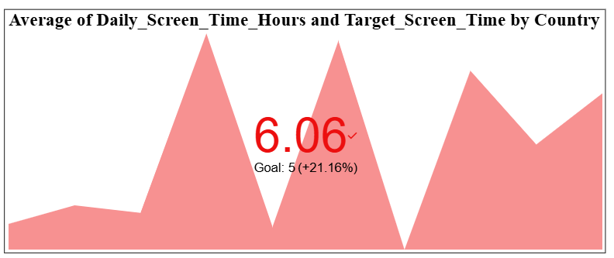
Camtasia Recording Toolbar
KPI – Average and Target Daily Screen Time by Country
Begin
recording
Toggle camera
recording
Adjust specific
recording options
This chart compares actual daily screen time with the target screen time.
The average screen time is 6.06 hours, which is higher than the goal of 5 hours.
It shows that screen time exceeds the healthy limit in many countries.
Toggle microphone
recording
Display camera
preview

Slide 7
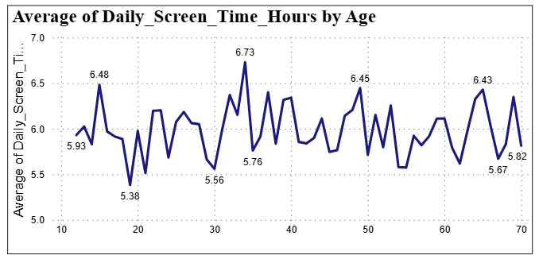
Camtasia Recording Toolbar
.
Line Chart – Average of Daily Screen Time by Age
Begin
recording
Toggle camera
recording
Adjust specific
recording options
Shows how mobile screen time varies across different age groups.
Most users spend between 5.5 and 6.5 hours per day on their phones.
Users in the age group of 30 to 40 show slightly higher screen time.
High screen usage is seen in almost every age group, indicating widespread dependence on mobile phones.
Toggle microphone
recording
Display camera
preview

Slide 8
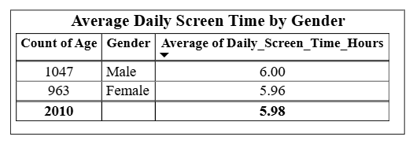
Camtasia Recording Toolbar
Table – Gender-wise Screen Time Comparison
Begin
recording
Toggle camera
recording
Adjust specific
recording options
Shows the average mobile screen time for male and female users.
Male users spend slightly more time on mobile phones than female users.
Female users have a similar screen time close to male users.
The total average screen time of all users is around 5.98 hours per day.
This helps understand mobile usage differences based on gender.
Toggle microphone
recording
Display camera
preview

Slide 9
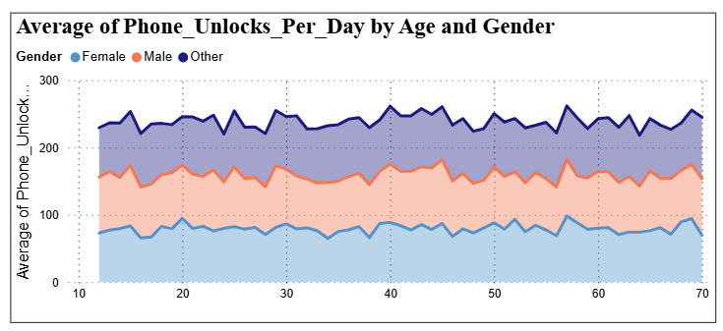
Camtasia Recording Toolbar
Area Chart – Phone Unlocks by Age & Gender
Begin
recording
Toggle camera
recording
Adjust specific
recording options
This visual shows that people unlock their phones frequently across all age groups, indicating regular mobile usage.
Males generally unlock their phones slightly more times per day compared to females.
Phone usage remains consistently high across different ages, reflecting ongoing mobile dependency.
Toggle microphone
recording
Display camera
preview

Slide 10
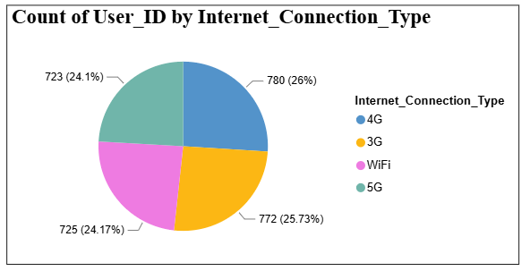
Camtasia Recording Toolbar
Pie Chart – Internet Connection Types Used by Users
Begin
recording
Toggle camera
recording
Adjust specific
recording options
This visual shows the distribution of users based on internet connection types (4G, 3G, WiFi, and 5G).
4G has slightly more users compared to the other connection types.
Users are fairly evenly distributed across 3G, WiFi, and 5G, showing mixed internet usage.
Toggle microphone
recording
Display camera
preview

Slide 11
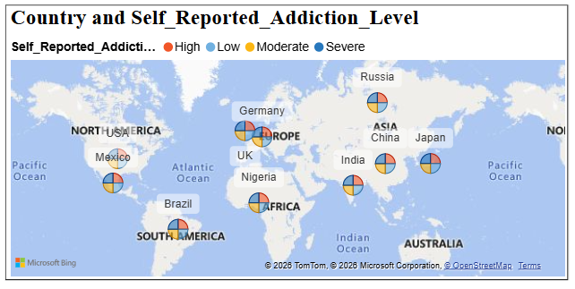
Camtasia Recording Toolbar
Map – Country and Self-Reported Addiction Level
Begin
recording
Toggle camera
recording
Adjust specific
recording options
This map shows mobile addiction levels in different countries.
Each pie chart represents low, moderate, high, and severe addiction.
Many countries show moderate to high mobile addiction levels.
Toggle microphone
recording
Display camera
preview

Slide 12
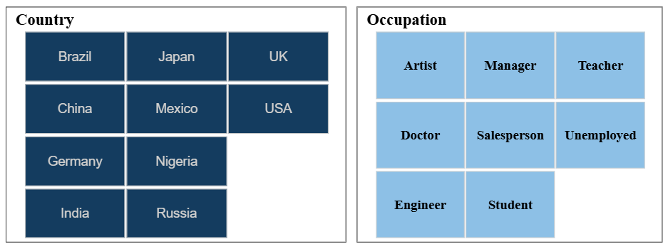
Camtasia Recording Toolbar
.
Slicer – Interactive Filters: Country & Occupation
Begin
recording
Toggle camera
recording
Adjust specific
recording options
The Country slicer allows users to filter data by selecting specific countries such as India, USA, UK, etc.
The Occupation slicer helps filter users based on their profession like Student, Engineer, Doctor, etc.
Using both slicers together makes it easy to analyze data for specific combinations of country and occupation.
Toggle microphone
recording
Display camera
preview

Slide 13

Camtasia Recording Toolbar
.
Begin
recording
Toggle camera
recording
Adjust specific
recording options
Toggle microphone
recording
Display camera
preview

